Slide 1
ROSE Lunch Meeting
September 2018

Slide 2
ROSE: The Story So Far

Slide 3

The Beginning
Fall 2015: Sarah Adkins (then my undergrad trainee) and I read Scientific Teaching together as a “journal club” style exercise

Slide 4
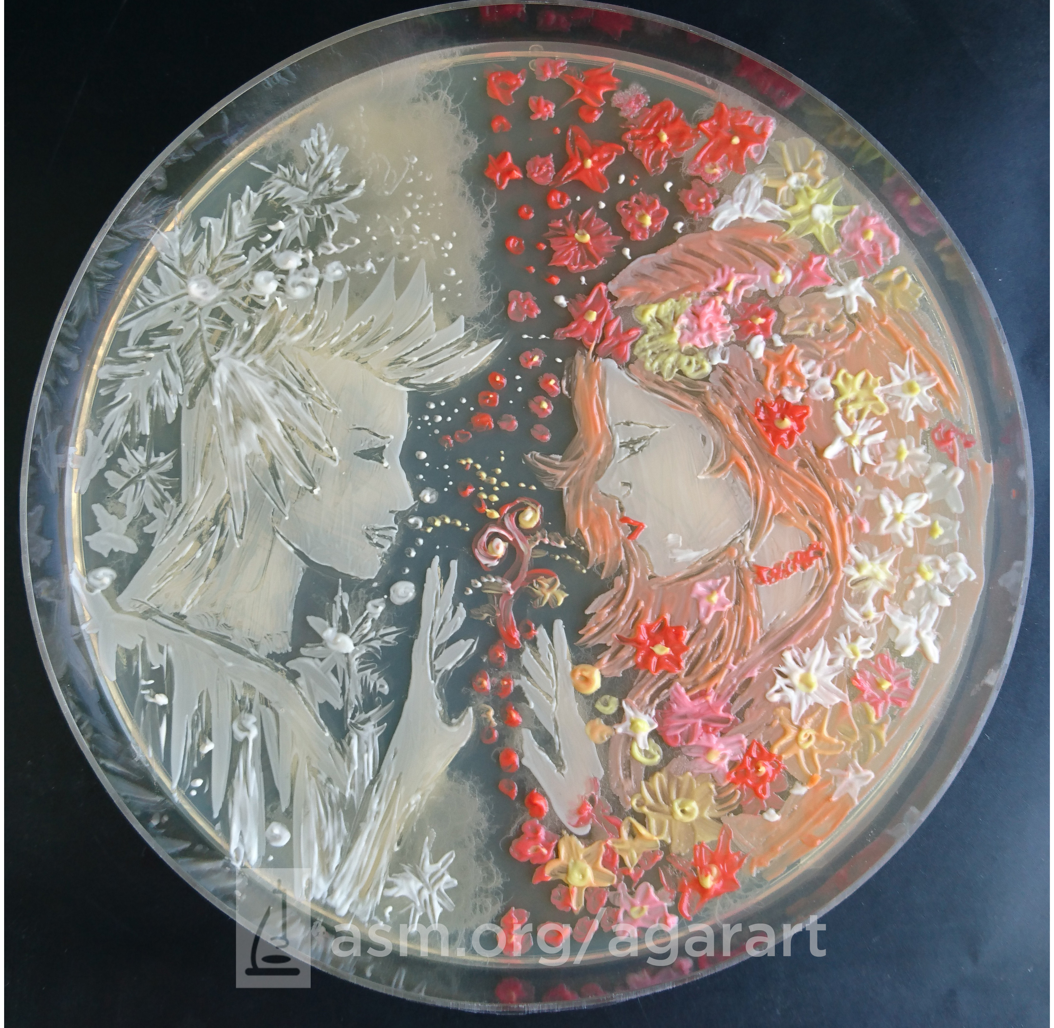

Active Learning in Microbiology
2018 Winner, The Battle of Winter and Spring, Ana Tsitsishvili
Inspired by the ASM agar art contest, in Spring 2016 Sarah and I developed the idea to build an intro micro course around “painting with bacteria”
We piloted the course with a few volunteers in Fall 2016

Slide 5
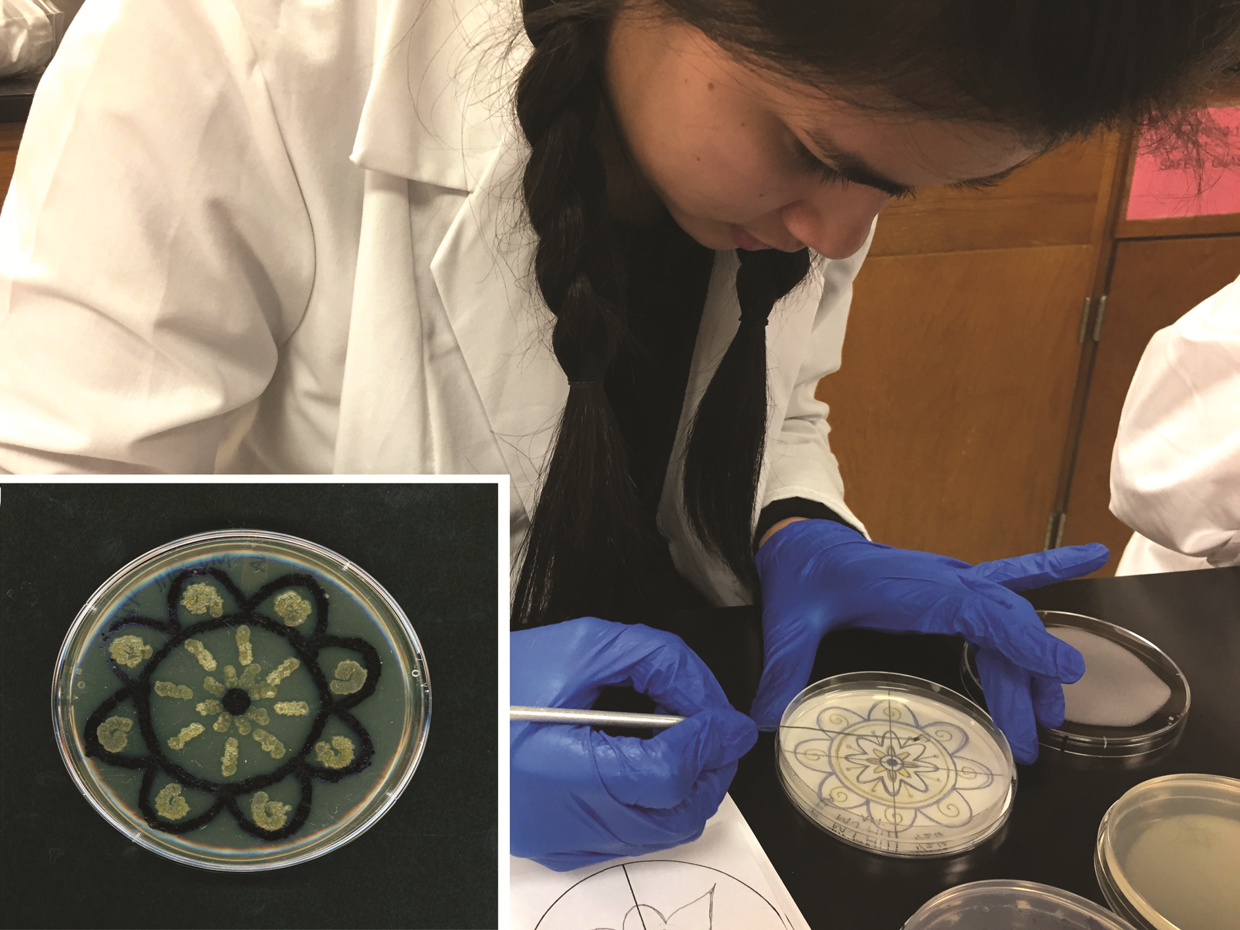
From Course to CURE
Funding from the UAB “Learning in a Team Environment” QEP
Can painting with bacteria be more than a fun diversion?
Agar art is alive – it’s a multispecies ecosystem
In Spring and Fall 2017 we used art as the basis of a CURE in intro micro lab

Slide 6
Interspecies Interactions in Agar Art are Hard to Predict
Adkins et al. 2018, FEMS Microbiology Letters

Slide 7
Students discover neat stuff
Adkins et al. 2018, FEMS Microbiology Letters

Slide 8
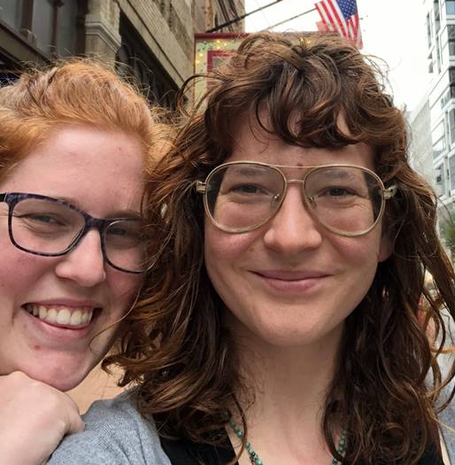
So maybe we know what we’re doing?
Rachel Rock
Sarah Adkins

Slide 9
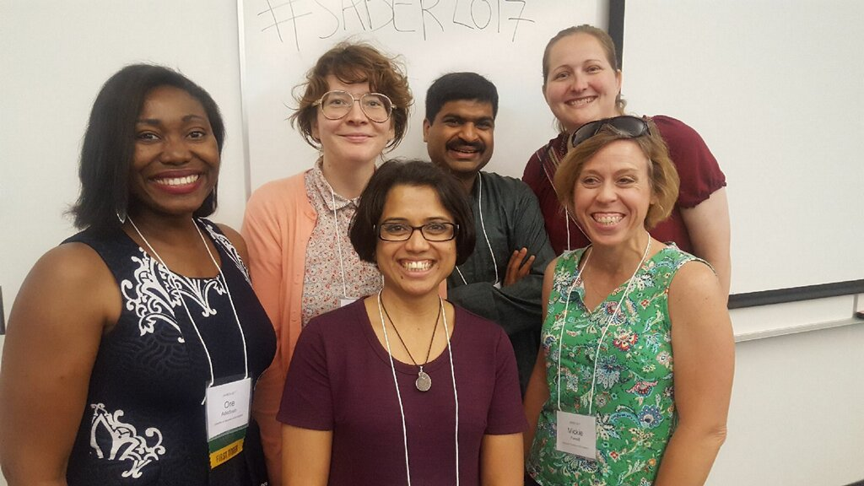
More Connections at UAB

Slide 10
Time to revisit Chapter 6?
It all started with a cute acronym…
Research On STEM Education = ROSE
(Get it? ROSE STEM? Anybody?)

Slide 11
When Sarah sent me a logo, it was on.

Slide 12
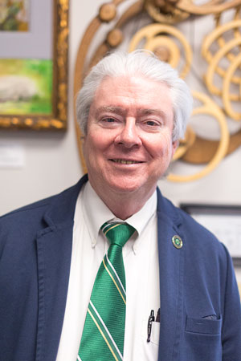
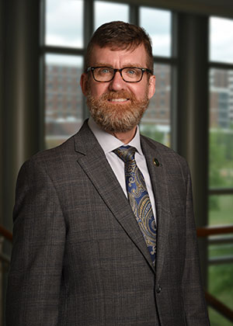
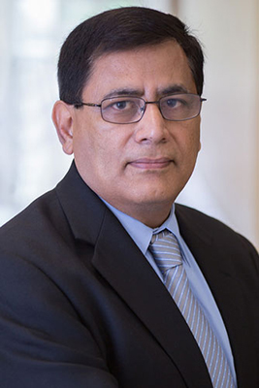
Initial Funding
John Mayer, UABTeach
Lee Meadows, UABTeach
Yogesh Vohra, CAS Associate Dean

Slide 13
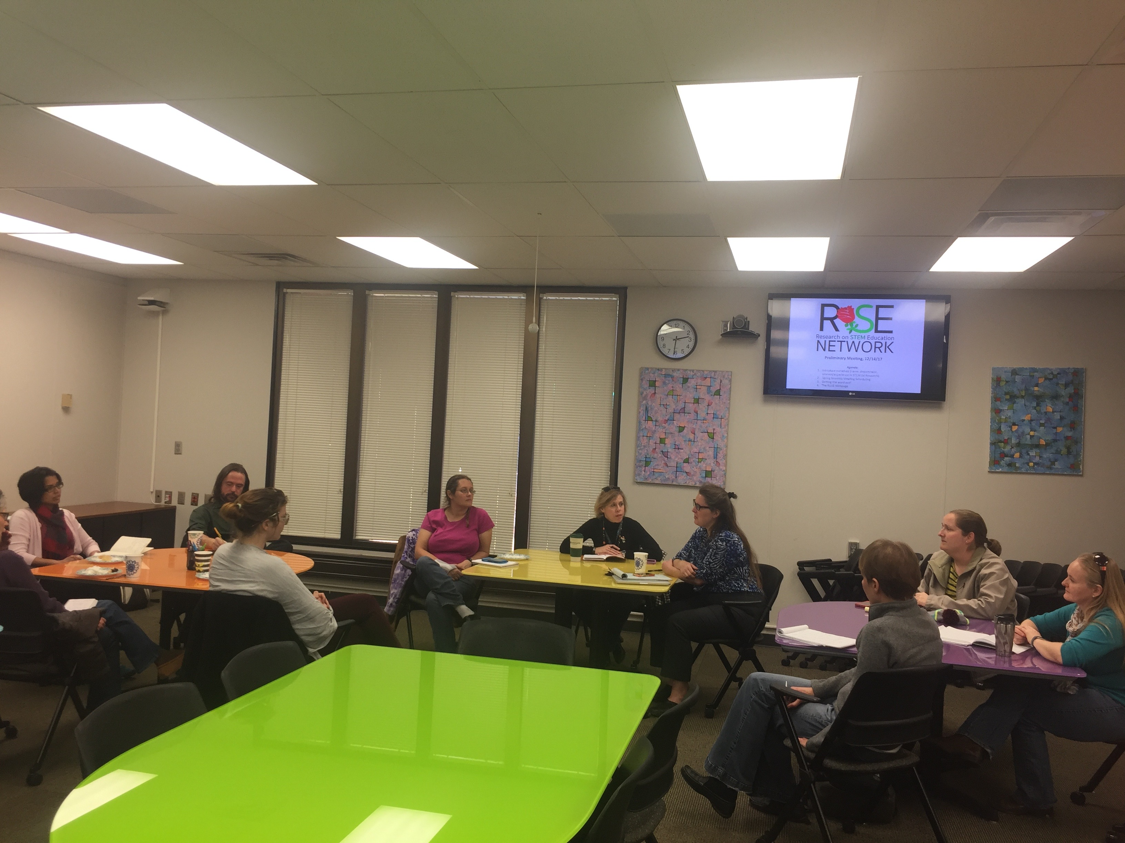
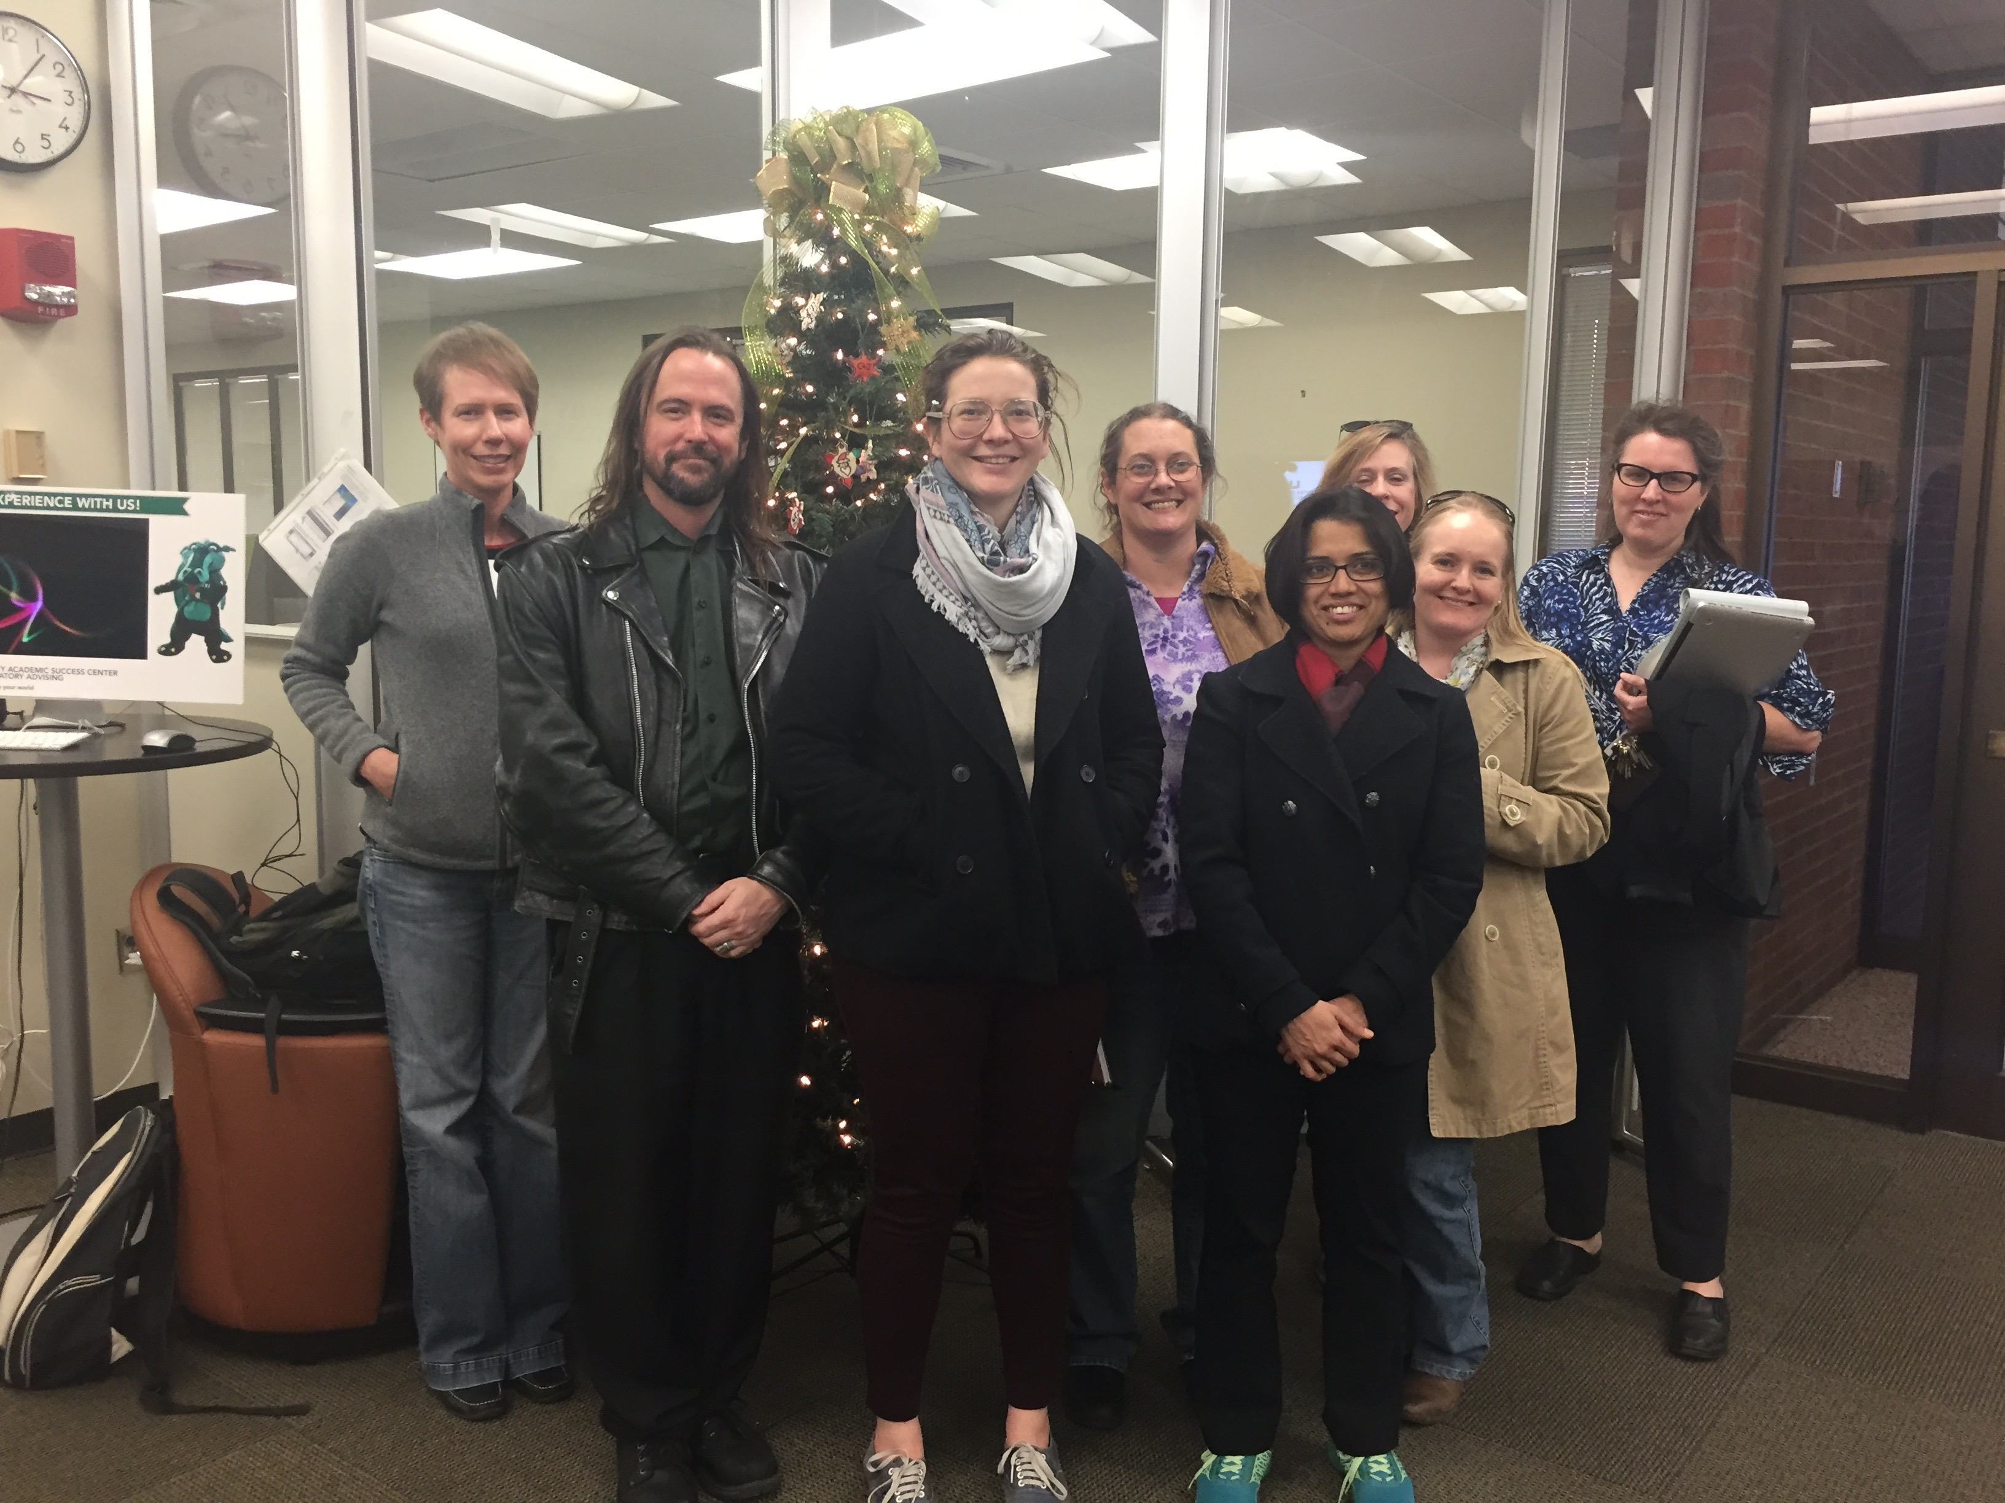
ROSE Planning Meeting
Dec 14, 2017 – Coffee and donuts!

Slide 14
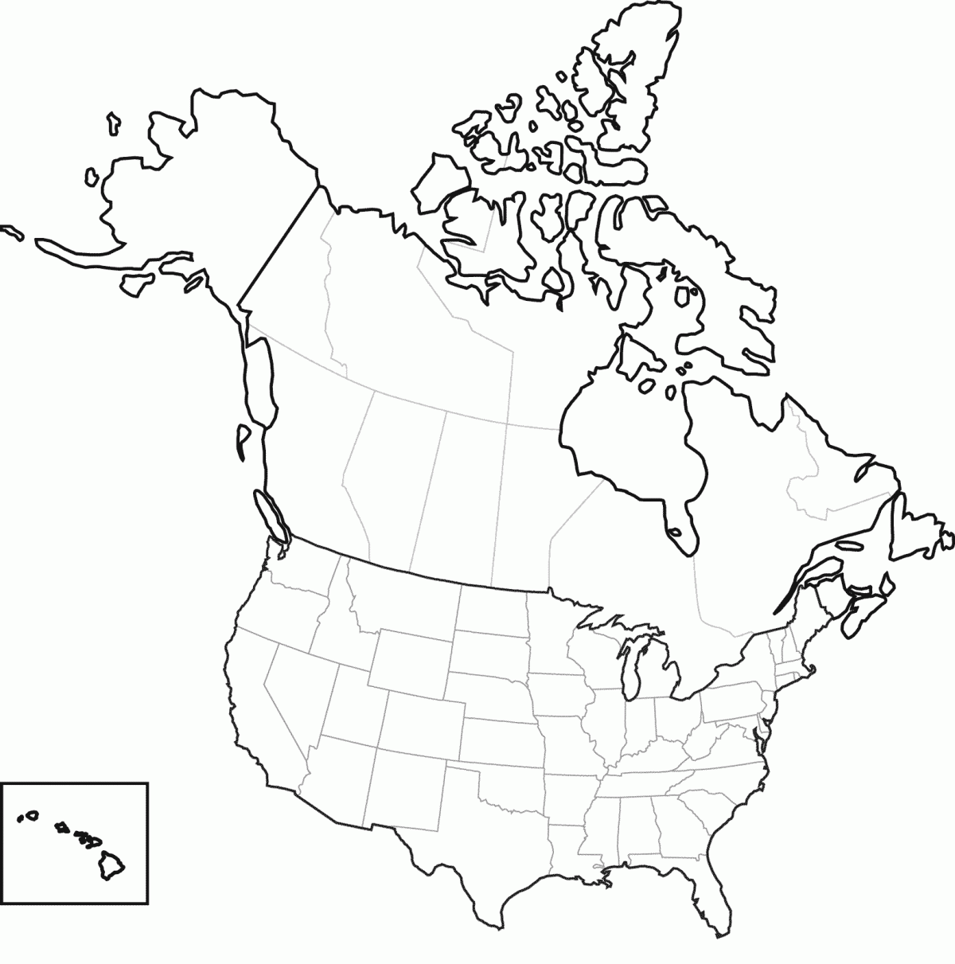
NSF RCN-UBE Call
Got word of the grant on Nov 15, it was due Jan 30. Why not try to assemble a nationwide network from scratch in a couple of months?

Slide 15
Meanwhile… ROSE Spring Meetings
January 24 – Introduction to ROSE Workshop
Feb 21 – Malcolm Campbell, Davidson College
March 20 – Denise Monti, Joint with ASM Student Branch Meeting
April 2 – Sara Brownell, Joint with UAB Department of Biology Seminar Series

Slide 16
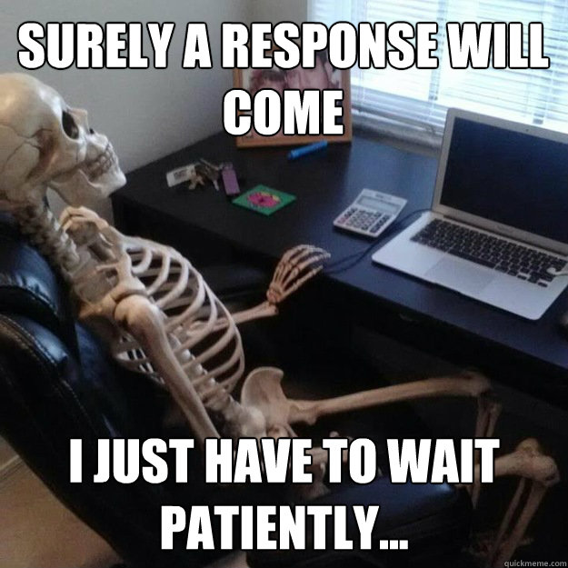
Waiting….

Slide 17

6/28/18 – FUNDED!
…as long as you can get all of this paperwork submitted in the next 10 days

Slide 18
ROSE Today – and tomorrow!
Alaska Fairbanks – 22% Native Alaskan, 13% veteran
Funded August 2018 – July 2023
3 “Hub Universities”
“Satellite Colleges”
  Jefferson State and Lawson State (Birmingham)
  EPCC
UAB – 25% African American
UTEP – 77% Hispanic American

Slide 19
The ROSE Mission
THE ROSE NETWORK: IMPROVING RESEARCH INCLUSIVITY THROUGH A GRASSROOTS CULTURE OF SCIENTIFIC TEACHING
“ROSE is dedicated to what Jo Handelsman called "scientific teaching" [23] -- the principle that the best way for scientists to become better teachers is to be scientific about their teaching. We believe that the most efficient way to extend the influence of active learning to more students is to inspire a culture of scientific teaching at the grassroots level -- that is, amongst the faculty who teach introductory STEM courses both at four-year and two-year universities.”

Slide 20
The ROSE Mission
THE ROSE NETWORK: IMPROVING RESEARCH INCLUSIVITY THROUGH A GRASSROOTS CULTURE OF SCIENTIFIC TEACHING
“We therefore propose that one of the most effective ways to improve retention of underrepresented minority students in Biology programs is to fund active learning reform at the community college level. In particular, we believe the introduction of Course-based Undergraduate Research Experiences (CUREs) is an ideal intervention for community colleges, as these courses directly involve students in authentic scientific discovery.”

Slide 21
ROSE 2018-2019 Meeting Schedule
Lunch Meeting Schedule 12-1:30 Central Time, CTL
Oct 3 – Rosianna Gray, Metacognition Workshop
Nov 7 -- TBD
Dec 5 – Jeff Olimpo, UAB Visit
Jan 16 – TBD
Feb 20 – TBD
Mar 20 – TBD
Apr 17 – TBD
Birmingham Chapter Socials (Cahaba Brewery): Oct 17, Nov 14, Dec 12, Jan 30, Mar 6, Apr 3
ROSE meetings can be workshop style or regular presentations. Wanna give one?

Slide 22
Funding Opportunities for ROSE Members
$500 travel grants to up to 6 ROSE members per year to attend the SABER conference
Telecommunications upgrades – up to $2K per hub university
Course Development Grants
  In 2019 and 2020, community college members can submit proposals for CURE development
  $1000 stipend, $500 for materials
  ROSE will hire a postdoctoral fellow to flesh out and implement winning proposals

Slide 23
ROSE Contact Info
rosenetwork.org
Jeff Morris -- evolve@uab.edu
Get on our mailing list (if you aren’t already)!

